Slide 1

Tunnel vision Mind Hacks
Florian TOPEZA
Arthur Jolivet

Slide 2
AP603 crash
October 2, 1996, Boeing 757, 70 people on board
Flying over water, at night, with no visual references, the pilots were unaware of their true altitude
Air data computers were unable to show correct airspeed and altitude on cockpit displays because a maintenance worker had failed to remove tape covering the pitot-static systems ports on the aircraft exterior
Pilots focused on trying to know their altitude and speed and forgot that altitude given by radar was wrong

Slide 3

Tunnel vision can happen to anybody, in any situation…
Chess
Exams
Driving
Surgery
Police investigations
Pilots
…

Slide 4
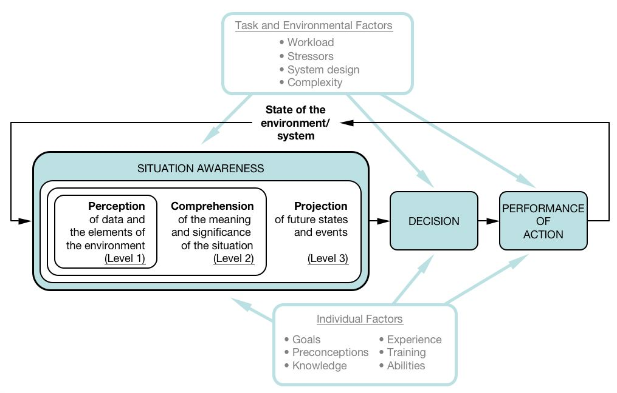
What science says…
Also known as loss of situational awareness
Endsley’s model with 3 levels

Slide 5

Sources
Wikipedia, Aeroperú Flight 603
Wikipedia, Situation awareness
Mayday, episode Flying Blind

